Slide 1
Loftium – Project Overview
Problem Statement
Loftium seeks to maximize Airbnb revenue from private rooms
Desired Outcome
A predictive model that best estimates recurring Airbnb revenue

Slide 2
Loftium – Project Overview
Project Scope
Explore Loftium data
Evaluate Loftium’s existing model
Scrape for additional data
Develop alternative predictive models

Slide 3
Exploring the Data
Laying out assumptions
Phase 1: Currently limited to Seattle
Target: Expected Monthly Revenue (EMR)
Expected Daily Revenue (EDR)
Project Priority:
Predictive accuracy
Statistical inference
Extra feature engineering
Notes:
What type of inference is needed?
What actions can you take based on what features you need?

Slide 4
Loftium – Project Overview
Project Scope
Explore Loftium data
Evaluate Loftium’s existing model
Scrape for additional data
Develop alternative predictive models

Slide 5
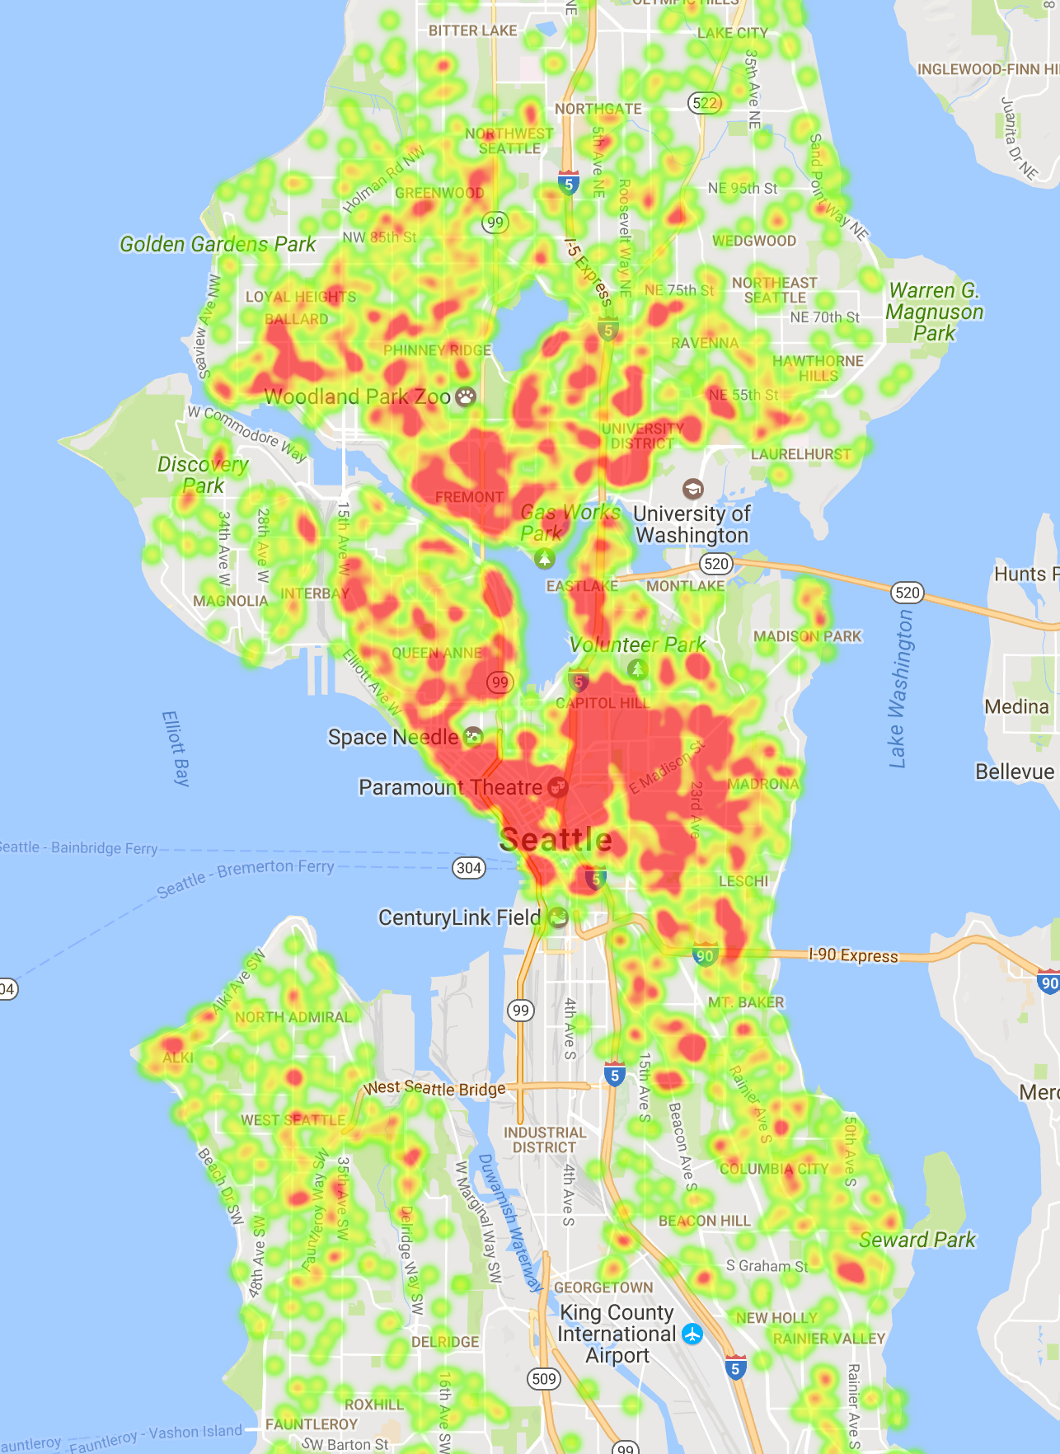
Identifying Hypotheses
Using initial hypotheses to define analytics strategy
EDR is driven by:
Location, location, location!
Seasonality
Host quality
Other features?
Density Heat Map
Seattle Airbnb Properties

Slide 6
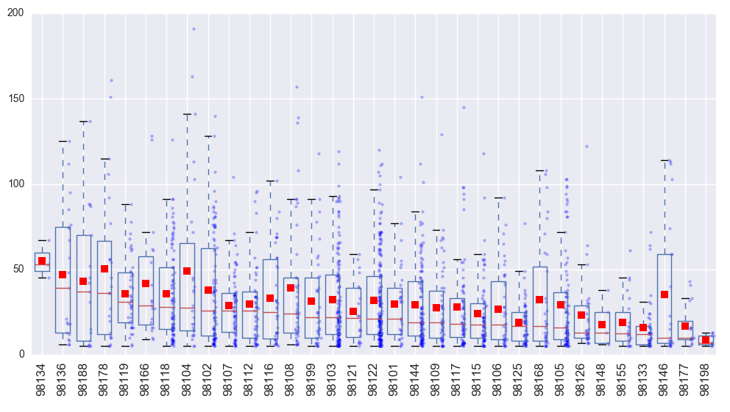
Location, Location, Location!
EDR varies by Zipcode… but significant variation within Zipcodes
EDR by Zipcode
EDR

Slide 7
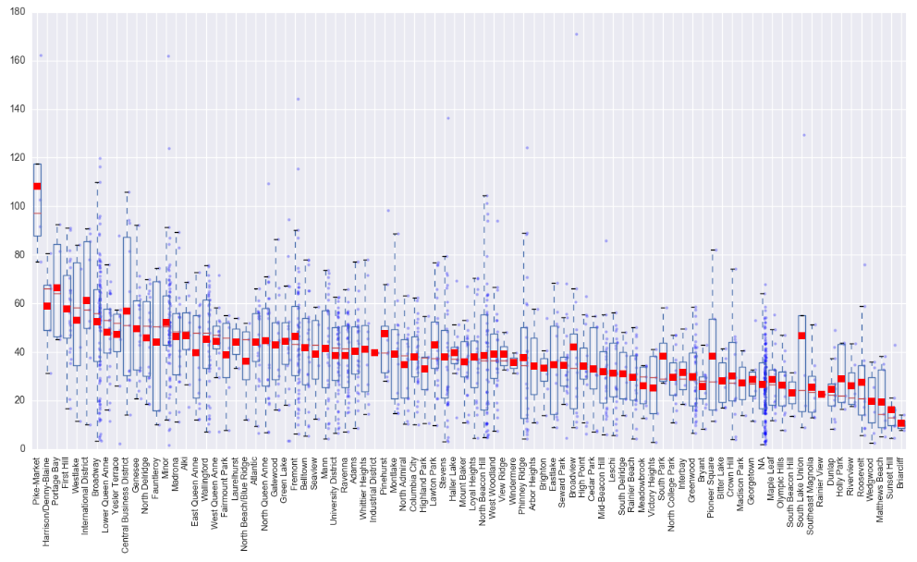
Location, Location, Location!
EDR varies by Neighborhood… but significant variation within Neighborhoods
EDR by Neighborhood
EDR

Slide 8
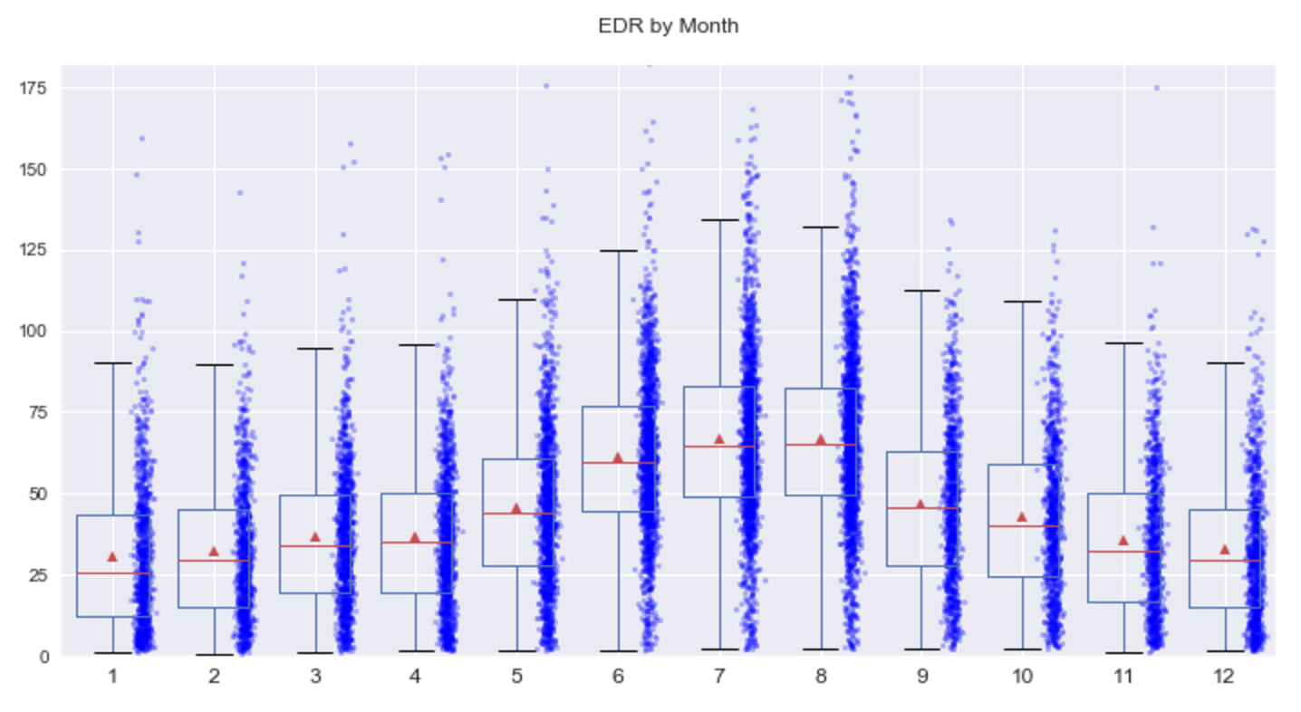
Exploring Seasonality
Significant seasonal impact on EDR
EDR by Month
EDR
Month

Slide 9
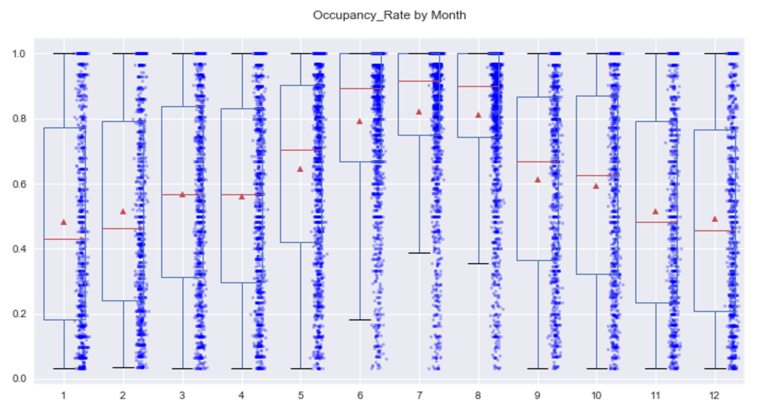
Exploring Seasonality
Seasonal impact on occupancy is more severe
EDR by Month
Occupancy Rate
Month

Slide 10
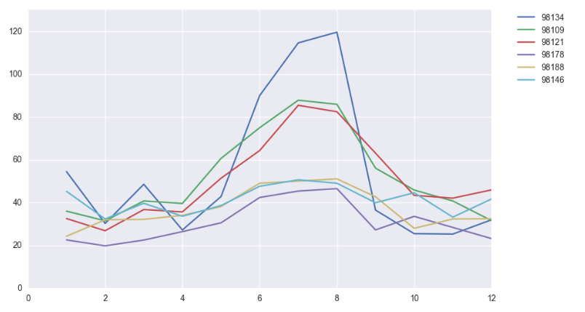
Exploring Seasonality
Certain areas exhibit more extreme seasonal variation
EDR by Month (by Zipcode)
Top 3 and Bottom 3 zipcodes by seasonal variation
EDR
Month

Slide 11
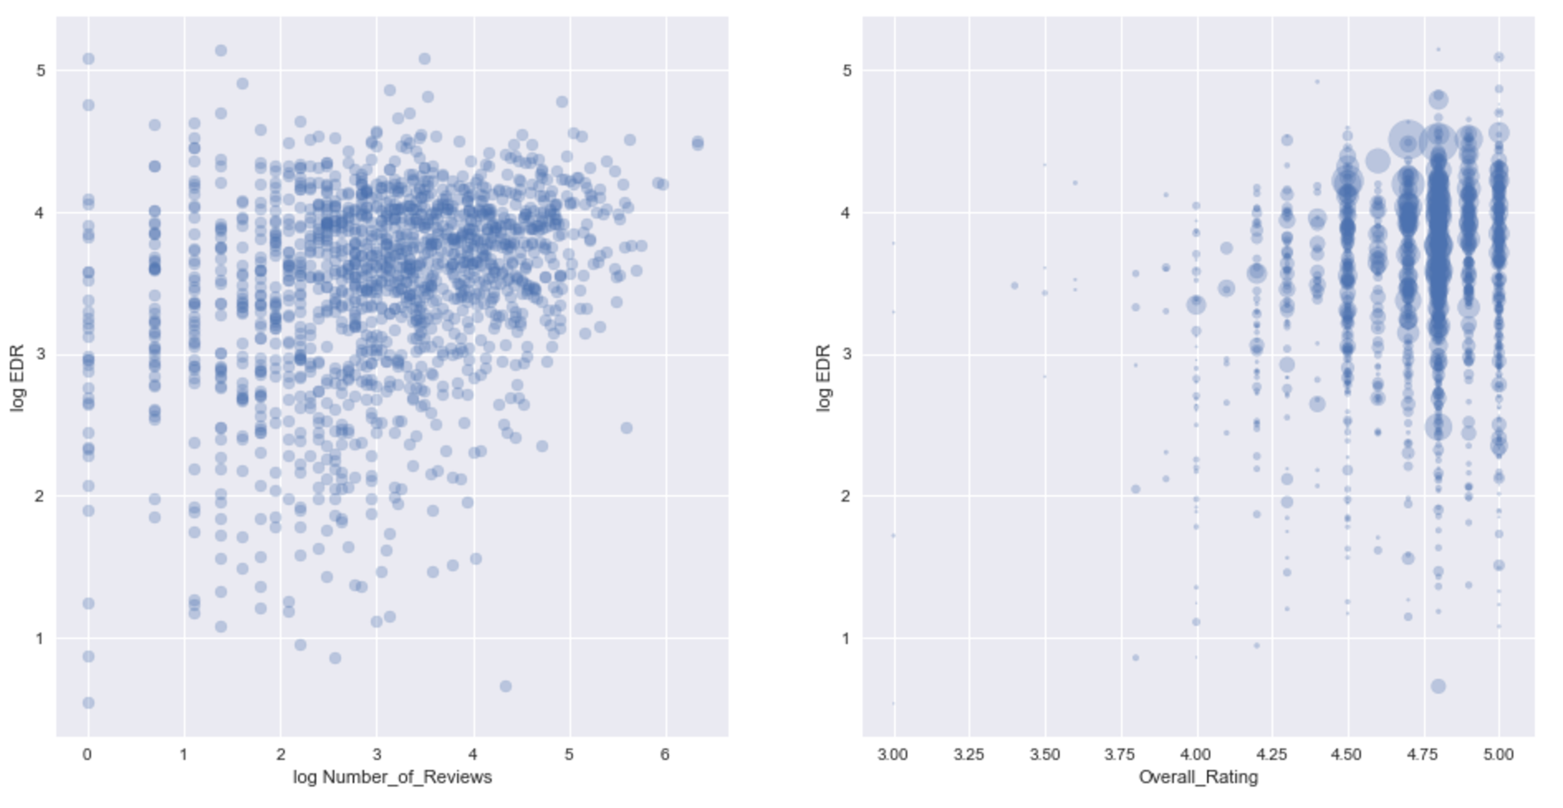

Exploring Host Quality
Occupancy increases with property ratings
Notes:
Make log=log plot

Slide 12
Data Exploration
Summary and Considerations
Significant variation in data
Significant presence of outliers
Strong seasonality impact
Host/Listing ratings are relevant
Granularity limited to month-level

Slide 13
Loftium – Project Overview
Project Scope
Explore Loftium data
Evaluate Loftium’s existing model
Scrape for additional data
Develop alternative predictive models

Slide 14
Evaluating Loftium Model
Scoring Metric = RMSE
RMSE heavily penalizes poor estimates
Sensitive to outliers!
Current Model RMSE = 24.7
On average, EDR predictions are off by $25
Seems high, but tremendous amount of noise in data
Mispriced listings
Minimal reservation days
Data integrity issues?
Are there specific segments that we can focus on to reduce the noise?
Notes:
Better metric – absolute value or deviance function for distribution (gamma).

Slide 15
Improving Loftium Model
Recommendations
Reduce data noise by focusing on properties that are in Loftium’s “sweet spot”
Consider a tiered-model structure that optimizes prediction for each tier
Generalize model to avoid hard-coded seasonality per Zipcode
Identify additional features that can be systematically added to the model
Evaluate better evaluation metric

Slide 16
Loftium – Project Overview
Project Scope
Explore Loftium data
Evaluate Loftium’s existing model
Scrape for additional data
Develop alternative predictive models

Slide 17
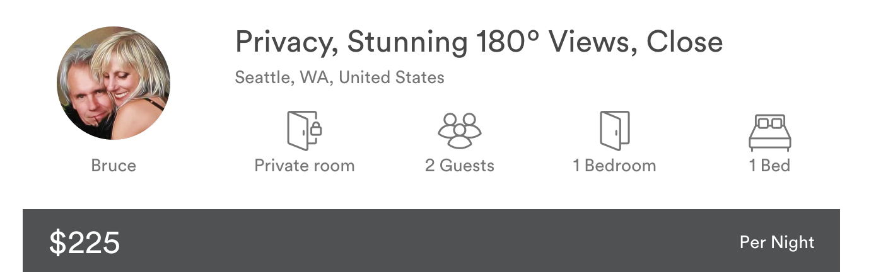
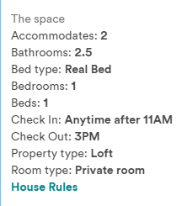
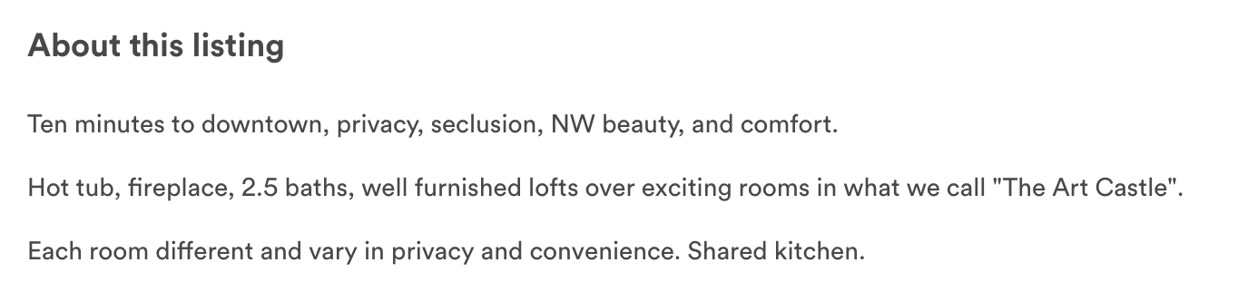
Finding Additional Features
Using NLP to extract meaningful features
Natural Language Processing
https://www.airbnb.com/rooms/4597013

Slide 18
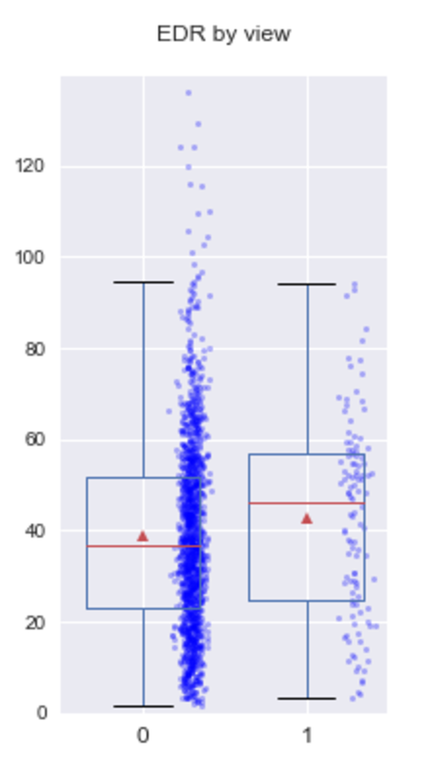
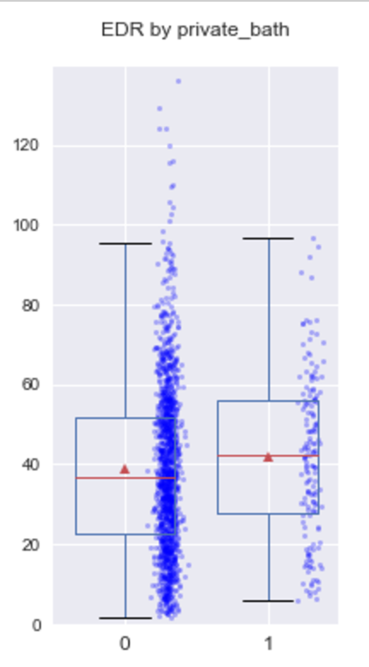
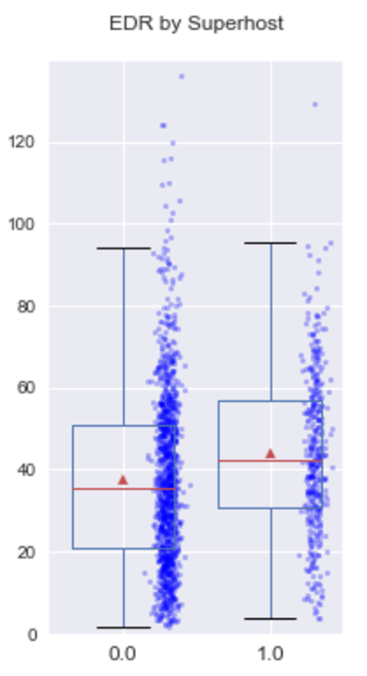
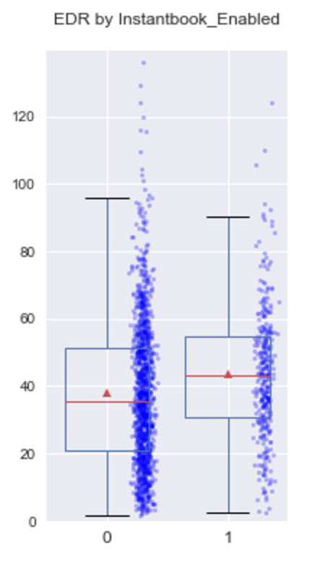
Finding Additional Features

Slide 19
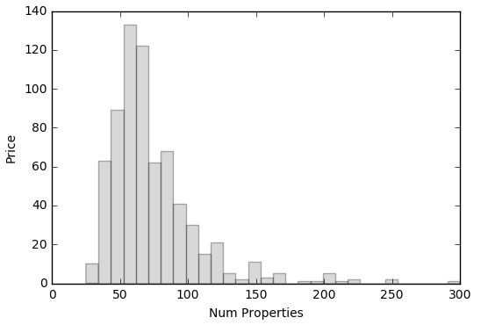
Text Mining
All Private Room Properties (n = 693)
Rank | Bi-gram | # | %
1 | capitol hill | 84 | 12%
2 | downtown seattle | 78 | 11%
3 | light rail | 68 | 10%
4 | walking distance | 47 | 7%
5 | private bathroom | 45 | 6%
6 | easy access | 43 | 6%
7 | street parking | 41 | 6%
8 | private bath | 40 | 6%
9 | bus lines | 37 | 5%
10 | blocks away | 36 | 5%
11 | minutes downtown | 32 | 5%
12 | coffee shops | 32 | 5%
13 | minute walk | 32 | 5%
14 | full bathroom | 28 | 4%
15 | west seattle | 28 | 4%

Slide 20
Text Mining
Private Rooms, Price < $50 (n = 116)
Rank | Bi-gram | # | %
1 | light rail | 18 | 16%
2 | coffee shops | 17 | 15%
3 | blocks away | 16 | 14%
4 | 10 minutes | 15 | 13%
5 | bus downtown | 14 | 12%
6 | university district | 13 | 11%
7 | downtown seattle | 12 | 10%
8 | away university | 11 | 9%
9 | minutes bus | 11 | 9%
10 | comfortable only | 11 | 9%
11 | best coffee | 11 | 9%
12 | downtown some | 11 | 9%
13 | university 10 | 11 | 9%
14 | some best | 11 | 9%
15 | ethnic restaurants | 11 | 9%

Slide 21
Text Mining
Private Rooms, $50 < Price < $75 (n = 307)
Rank | Bi-gram | # | %
1 | private bathroom | 44 | 14%
2 | light rail | 28 | 9%
3 | downtown seattle | 27 | 9%
4 | capitol hill | 24 | 8%
5 | easy access | 21 | 7%
6 | minute walk | 20 | 7%
7 | street parking | 19 | 6%
8 | bus lines | 19 | 6%
9 | walking distance | 18 | 6%
10 | west seattle | 17 | 6%
11 | quiet neighborhood | 14 | 5%
12 | minutes downtown | 13 | 4%
13 | columbia city | 13 | 4%
14 | shared kitchen | 13 | 4%
15 | queen size | 13 | 4%

Slide 22
Text Mining
Private Rooms, $75< Price < $100 (n = 179)
Rank | Bi-gram | # | %
1 | capitol hill | 32 | 18%
2 | downtown seattle | 28 | 16%
3 | private bathroom | 24 | 13%
4 | light rail | 17 | 10%
5 | walking distance | 14 | 8%
6 | street parking | 13 | 7%
7 | full bathroom | 12 | 7%
8 | one block | 11 | 6%
9 | bus lines | 11 | 6%
10 | queen anne | 10 | 6%
11 | within walking | 10 | 6%
12 | quiet neighborhood | 9 | 5%
13 | washer dryer | 9 | 5%
14 | access downtown | 8 | 4%
15 | lake washington | 8 | 4%

Slide 23
Text Mining
Private Rooms, Price > $100 (n = 91)
Rank | Bi-gram | # | %
1 | capitol hill | 25 | 27%
2 | downtown seattle | 11 | 12%
3 | private bath | 8 | 9%
4 | walking distance | 7 | 8%
5 | blocks away | 6 | 7%
6 | just few | 5 | 5%
7 | street just | 5 | 5%
8 | quiet street | 5 | 5%
9 | few blocks | 5 | 5%
10 | light rail | 5 | 5%
11 | lake washington | 5 | 5%
12 | minutes downtown | 5 | 5%
13 | minute walk | 5 | 5%
14 | vibrant music | 4 | 4%
15 | pike place | 4 | 4%

Slide 24
Loftium – Project Overview
Project Scope
Explore Loftium data
Evaluate Loftium’s existing model
Scrape for additional data
Develop alternative predictive models

Slide 25
Alternative Predictive Models
Scoring Metric = RMSE
RMSE heavily penalizes poor estimates
Sensitive to outliers!
Current Model RMSE = 24.7
Gradient Boosted Regression = 24.0
Based on equivalent sampling
Notes:
Built equivalent model based on my limited understanding of business.

Slide 26
Loftium – Next Steps
Model Refinement
Property segmentation
Hyperparameter tuning
Part of speech analysis
Explore statistical inference models
GLMs
Alternative Questions to Explore:
Customer acquisition probabilistic model
Customer segmentation/clustering
Day-level predictive model

Slide 27
Appendix

Slide 28
Features used in Gradient Boosting
listing_gdbr_cols_keep = [
# ==== LISTING DETAILS ==========
'Bathrooms', 'Bedrooms',
'Days_Since_Created', 'Number_of_Photos','Instantbook_Enabled',
# ---- Exclude
#'Property_ID', 'Listing_Title', 'Listing_Main_Image_URL','Listing_URL','Created_Date',
#'Check-in_Time', 'Checkout_Time', 'Max_Guests', 'Minimum_Stay',
# ==== BOOKING HISTORY =========
'EDR',
# ---- Exclude
#'Occupancy_Calculated', 'Annual_Revenue_LTM', 'Average_Daily_Rate' 'Last_Scraped_Date','Calendar_Last_Updated',
#'Number_of_Bookings_LTM','Count_Blocked_Days_LTM', 'Count_Reservation_Days_LTM','Count_Available_Days_LTM',
# ==== LOCATION ================
'Latitude', 'Longitude',
# ---- Exclude
#'Country', 'State','City', 'Metropolitan_Statistical_Area',
# ==== EXTENDED STAY DETAILS ===
# --- -Exclude
#'Published_Monthly_Rate','Published_Nightly_Rate', 'Published_Weekly_Rate',
# ==== ADDITIONAL FEES =========
'Security_Deposit', 'Extra_People_Fee', 'Cleaning_Fee',
# ==== HOST QUALITY ============
'Superhost', 'Overall_Rating','Number_of_Reviews',
# ---- Exclude
#'Response_Rate', 'Response_Time_min',
# ==== SPECIAL FEATURES ========
'Pike_Market', 'nonroom', 'private_bath', 'view', 'water',
# ---- Exclude
#'walk',
]
listing_gdbr_cols_dummy = [
#'Neighborhood',
#'Zipcode',
'Cancellation_Policy',
'Property_Type'
]

